Slide 1


Calculating Tumor and Necrotic Radius From Images
Furkan Kurtoglu
@FkurtogluSysBio
Image Processing
5/1/2019

Slide 2
Outline
Introduction
Biological Background (Very Short)
Problem Definition
Methods
Work Flow
Results
Demo
Future Works

Slide 3
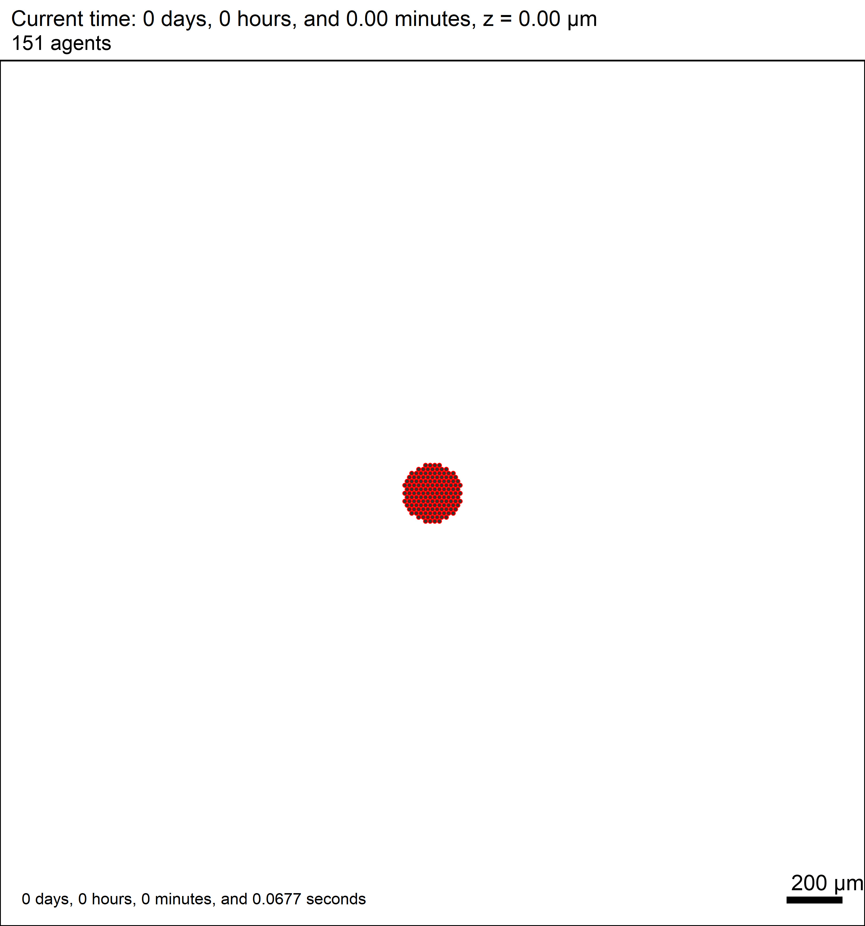
Introduction - Biological Background
Tumor radius is increasing by time because it’s growing.
Cells in tumor uses oxygen to grow.
However, tumor is killing vasculature which supplies oxygen to the environment.
Therefore, in the middle of tumor, oxygen is depleted by tumor cells.
Hence, the middle cells are dying due to lack of oxygen.

Slide 4
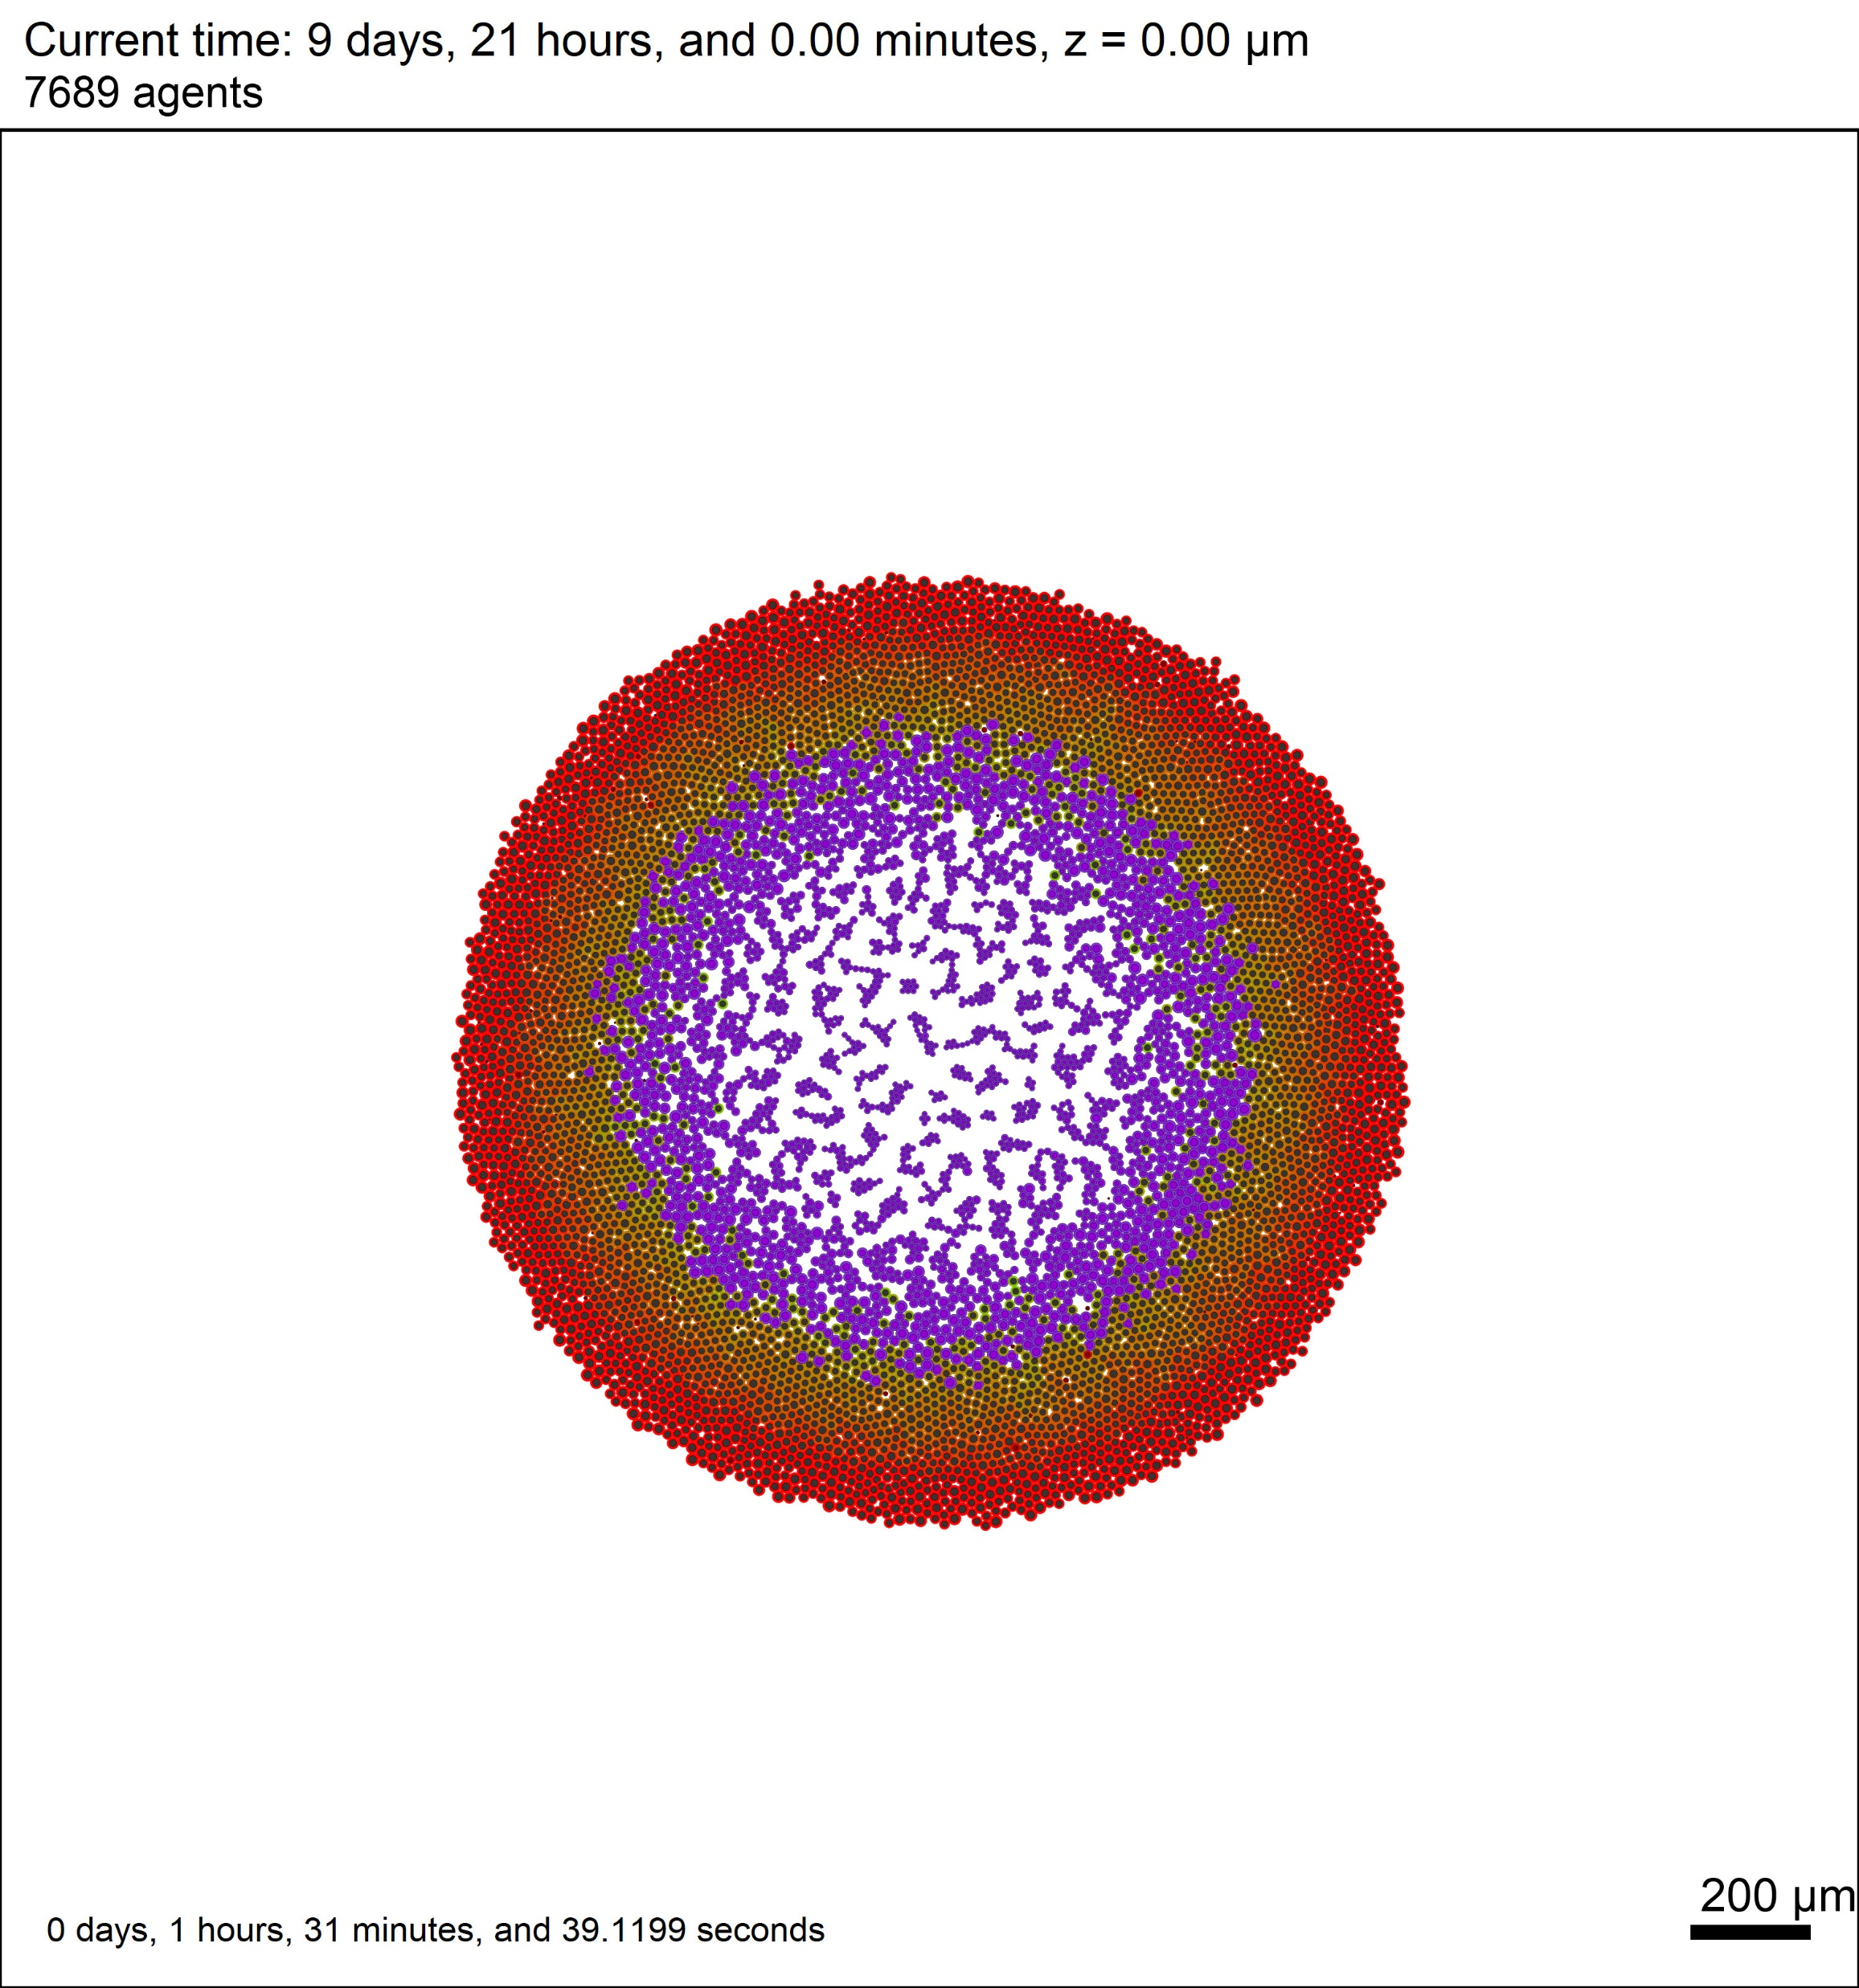
Introduction - Problem Definition
Simulating by time and producing simulation results
Calculating Tumor Radius and Necrotic Radius from simulation images for each time step.
This results will be used to calibrate our Model Parameters to be consisted with experimental results.
Tumor area
Necrotic area

Slide 5
Methods - Work Flow
Cropping
Closing
Blurring
Masking
Calculation of Radius
Finding and Drawing Contours

Slide 6
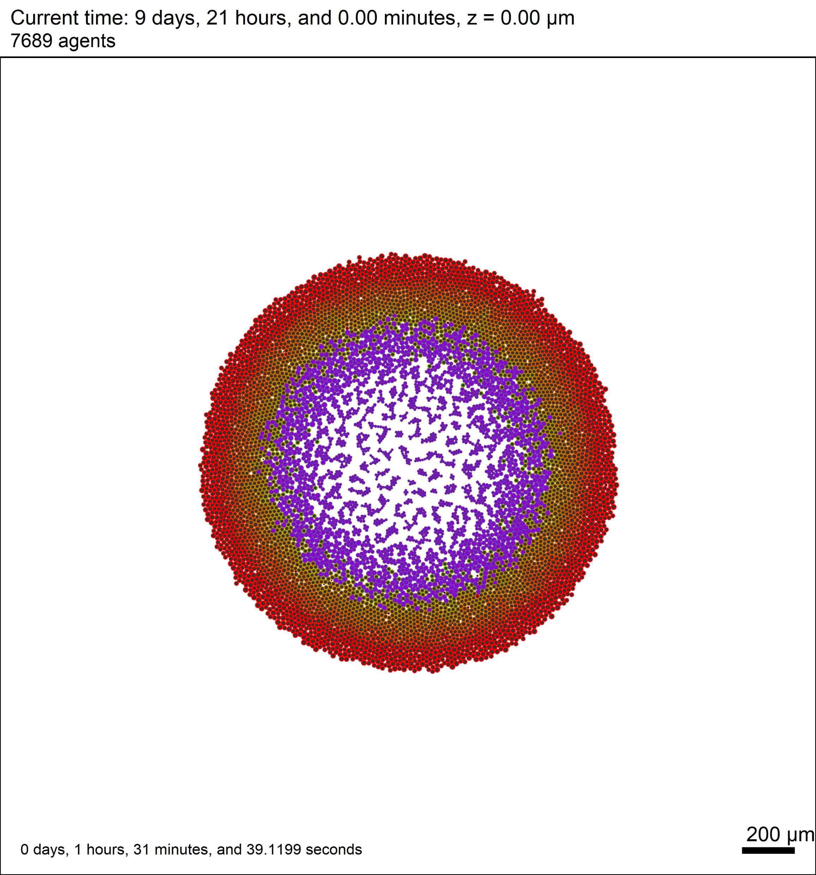
Methods - Croping

Slide 7
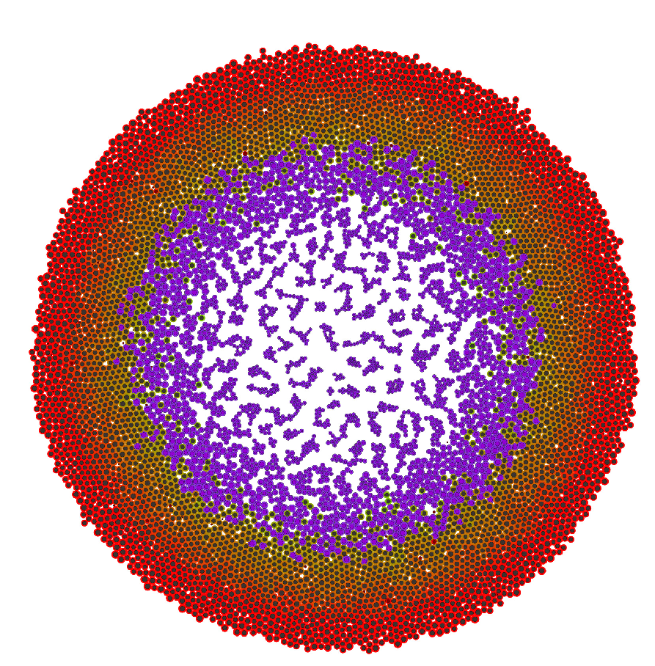
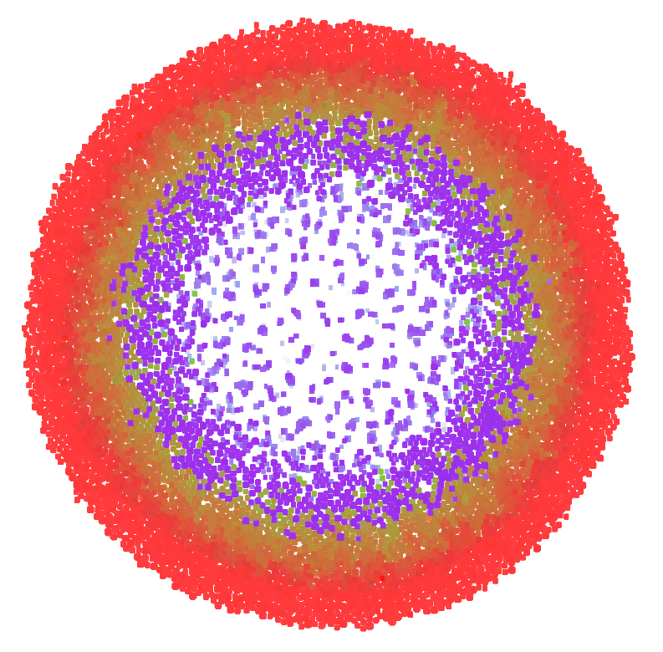
Methods - Closing
Closing
- With Kernel (12,12)

Slide 8
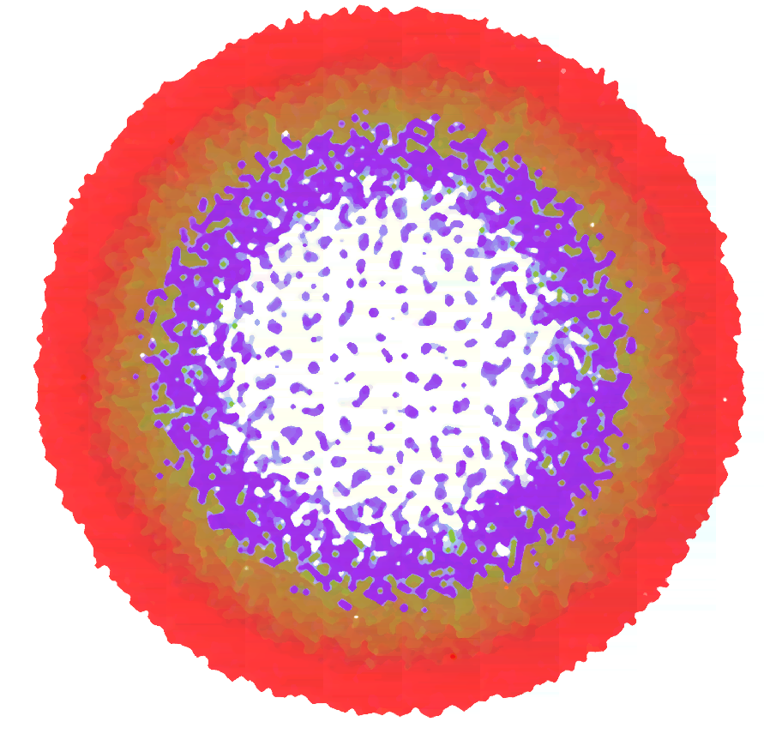
Methods - Blurring
Median Blur with 15 pixel size

Slide 9
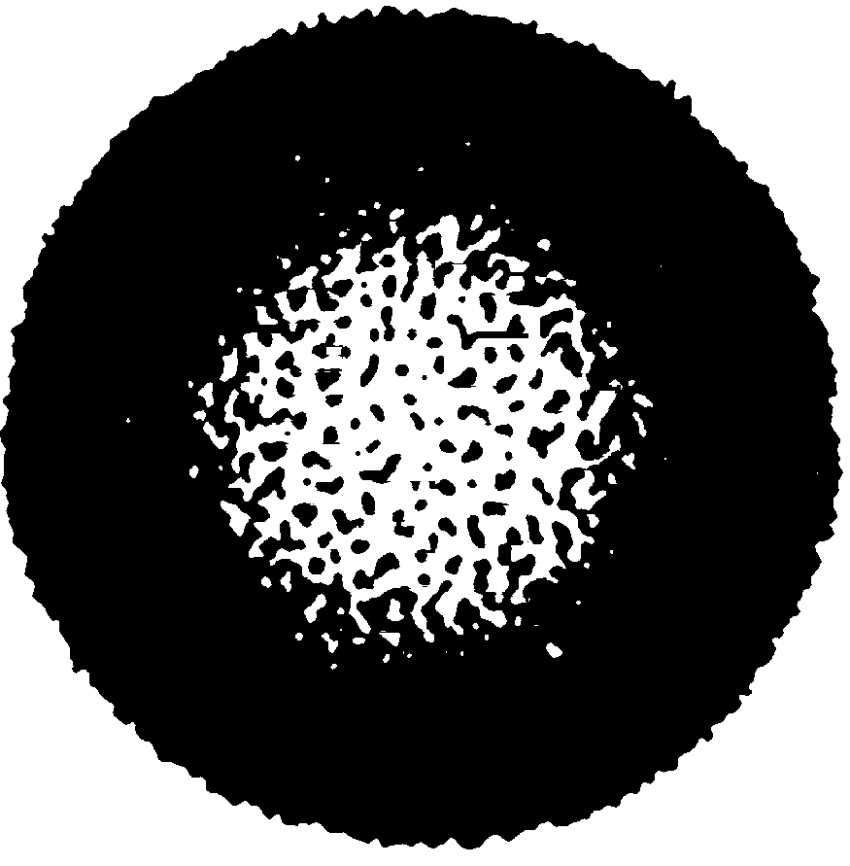
Methods – Binary Thresholding
Binary Thresholding to eliminate background and binary labeling

Slide 10
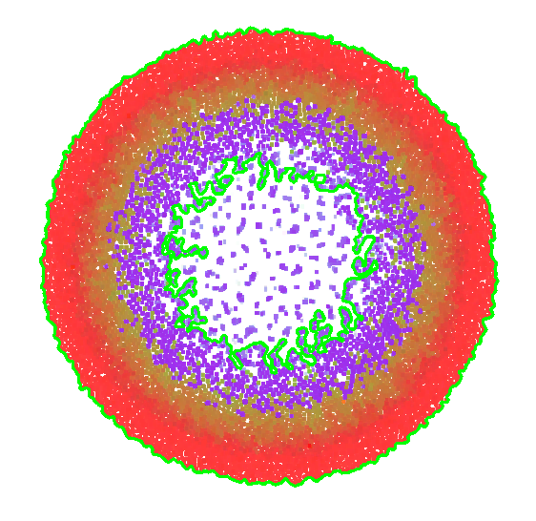
Methods – Finding Contours and Drawing Contours
If One Contour:
- Only tumor radius
Two Contour
- Big Contour is Tumor
- Small Contour is Necrotic

Slide 11
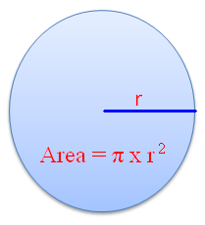
Methods – Radius Calculation
It is assumed that tumor grow in circular shape
Area to Radius

Slide 12
Results - Demo
Lets Do a Demo

Slide 13
Future Works
Each pixel is one micron
That can be changed in future
There is a measure bar at the bottom.
OCR to get number and calculate the tumor accordingly
Cell types between tumor gap and edge of tumor
It could be find these cells with HUE color space and selection of color with a saturation and value.
Or Clustering algorithm can be used to determine different type of cells.

Slide 14
Thank you so much!

